Slide 1

6th Grade Accelerated Math
Unit 3, Lesson 4 Plotting, Ordering, and Comparing Rational Numbers – Part 2 Volume 1, pg. 93

Slide 2


Benchmark
MA.6.NSO.1.1
Extend previous understanding of numbers to define rational numbers. Plot, order, and compare rational numbers.
volume 1, pg. 93

Slide 3
Integrated Mathematical Thinking and Reasoning Standards
MA.K12.MTR.2.1 Demonstrate understanding by representing problems in multiple ways.
MA.K12.MTR.4.1 Engage in discussions that reflect on the mathematical thinking of self and others.
volume 1, pg. 93

Slide 4

Learning Target
I can plot, compare, and order rational numbers.
volume 1, pg. 93

Slide 5

Warm-Up
volume 1, pg. 93

Slide 6
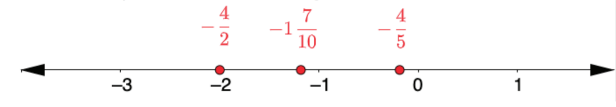
3.4.1 Warm-Up: Find the Error
A student plotted the following numbers.
1. Which values are plotted correctly?
2. Which values are NOT plotted correctly?
volume 1, pg. 93

Slide 7

Activity
volume 1, pg. 94

Slide 8

3.4.2 Activity: Class Number Line
Your teacher will give you a sticky note with a rational number written on the front.
Write your name on the back of the sticky note and place your number in the correct location on the class number line.
volume 1, pg. 94

Slide 9

Exploration
volume 1, pg. 94

Slide 10

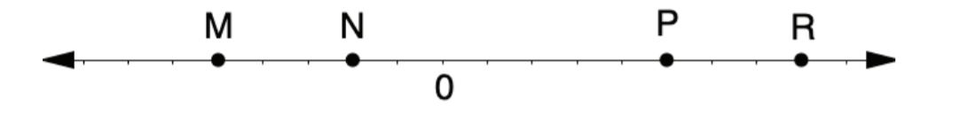
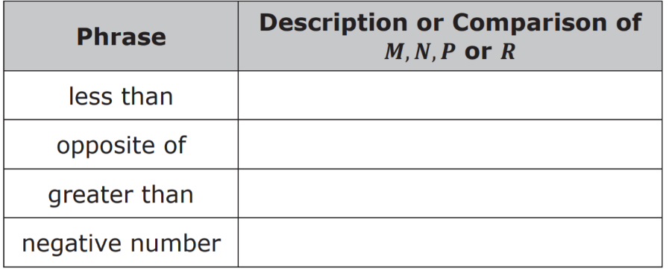
3.4.3 Exploration: Comparing Points on a Number Line
A number line is shown with points 𝑀, 𝑁, 𝑃, and 𝑅. Work with your partner to answer the questions about the number line.
1. Use each of the given phrases to describe or compare the values of points 𝑀, 𝑁, 𝑃, 𝑅. Each statement will use one or two of the points.
volume 1, pg. 94

Slide 11
2. If 𝑃 is 2½, what are the values of 𝑀, 𝑁, and 𝑅?
3. If 𝑁 is −0.4, what are the values of 𝑀, 𝑃, and 𝑅?
4. If 𝑅 is 200%, what are the values of 𝑀, 𝑁, and 𝑃?
5. If 𝑀 is −1⅔, what are the values of 𝑁, 𝑃, and 𝑅?
volume 1, pg. 94

Slide 12

Guided Instruction
volume 1, pg. 95

Slide 13
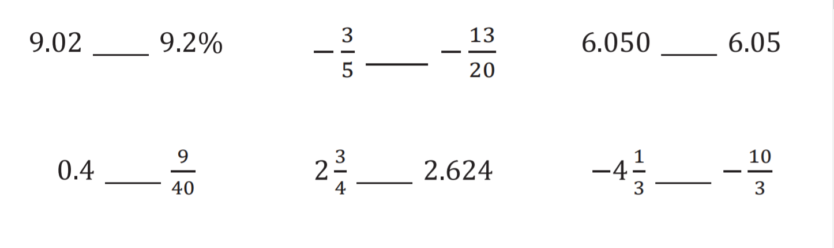
3.4.4 Guided Instruction: Comparing Rational Numbers in Different Forms
1. Use the symbols >, <, or = to compare each pair of values.
volume 1, pg. 95

Slide 14
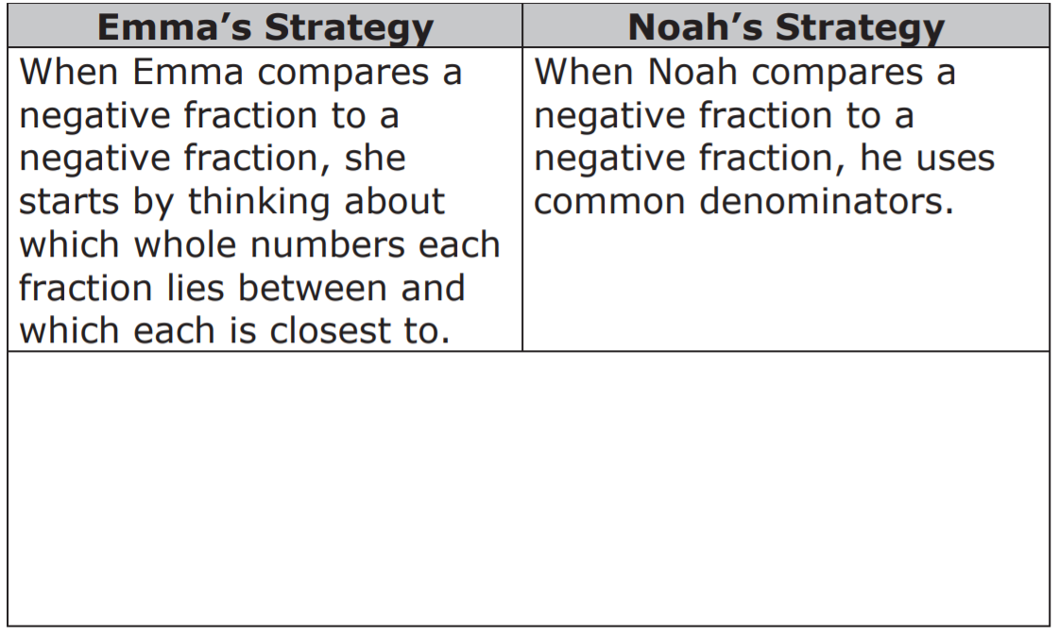
2. Emma and Noah shared their strategy for comparing values written as fractions. Write your strategy in the box and note any differences from Emma’s or Noah’s strategy.
volume 1, pg. 95

Slide 15
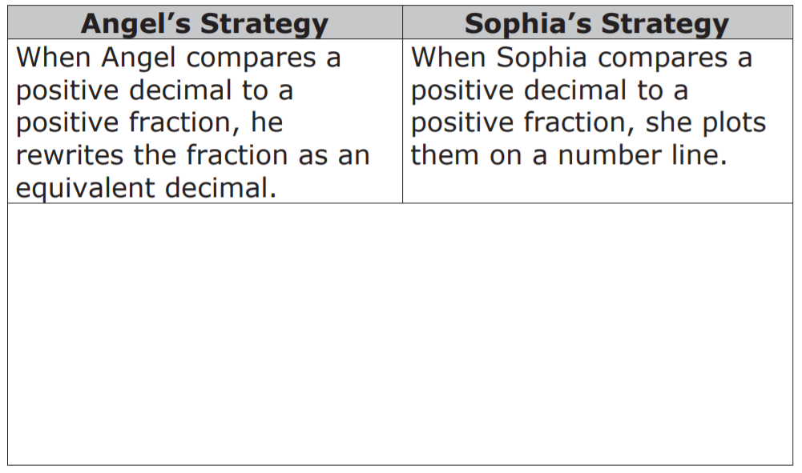
3. Angel and Sophia share their strategies for comparing a value written as a decimal to a value written as a fraction. Write your strategy in the box and note any similarities from Angel’s or Sophia’s strategy.
volume 1, pg. 96

Slide 16

Try It
volume 1, pg. 96

Slide 17

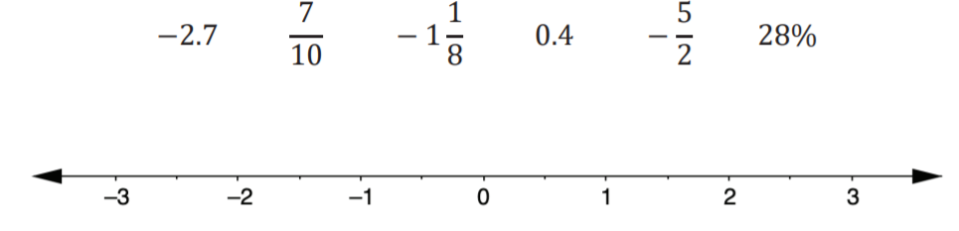
3.4.5 Try It: Plotting, Ordering, and Comparing Rational Numbers in Different Forms
1.
a. Plot each value on the number line. Label each point
with its numeric value.
b. What strategies did you use that were helpful
when plotting the rational numbers written in different forms on the number line?
c. Order the values from greatest to least.
volume 1, pg. 96

Slide 18

d. Complete the inequality statement to show
the relationship between the values plotted on the number line.
volume 1, pg. 96

Slide 19

Your Turn
volume 1, pg. 97

Slide 20
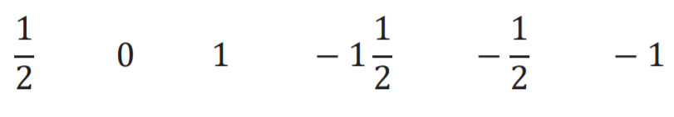

3.4.6 Your Turn!
Order the values from least to greatest.
Plot the values on the number line. Label each point with its numeric value.
volume 1, pg. 97

Slide 21
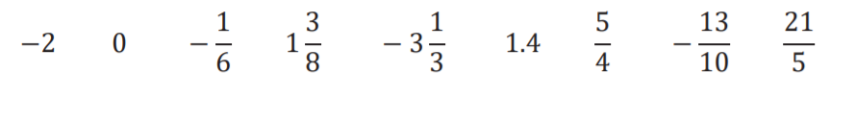
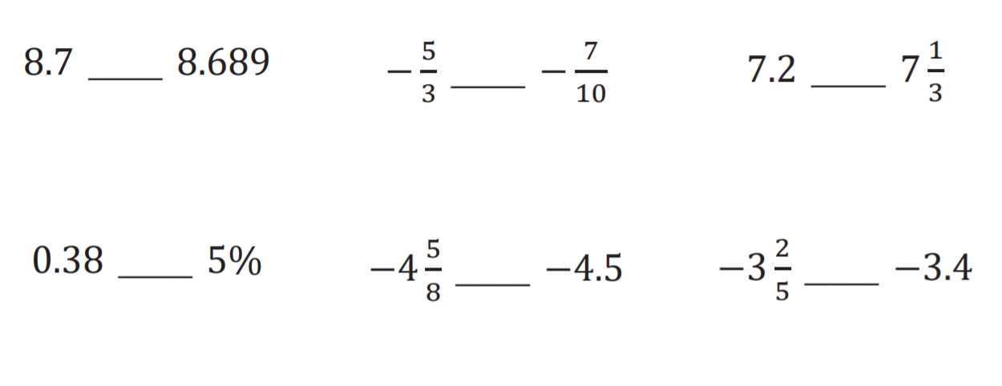
3. Order the values from greatest to least.
4. Use the symbols > , <, or = to compare each pair of values.
volume 1, pg. 97

Slide 22

Wrap-Up
volume 1, pg. 97

Slide 23
3.4.7 Wrap-Up: Ticket Out the Door
Use the values 3.6, −4 4/5 , 0.7, −1 1/5 , 15/4 , 89%, and − 7/8. Plot the values on the number line. Label each point with its numeric value.
List the values 3.6, −4 4/5, 0.7, −1 1/5, 15/4, 89%, and − 7/8 from least to greatest.
Use the symbols <, >, or = to compare each pair of values.
volume 1, pg. 97

